Slide 1
Swift
Kevin Donohue
COMP 471 001 F19
3rd September, 2019

Slide 2
Background on Swift
Released in June 2014 by Apple Inc.
Designers: Chris Lattner, Doug Gregor, Ted Kremenek, Joe Groff, and John McCall
Specifically designed for work with Apple operating systems (iOS, macOS, Darwin, Linux, etc.)
Meant to work with Cocoa and Cocoa Touch Framework
Uses Objective-C runtime library
Allows Swift, Objective-C, C, and C++ all to run within the same program
Describes itself as a “general-purpose, multi-paradigm, compiled, programming language”
General-purpose: software designed to be used in a wide variety of application domains
Multi-paradigm: Supports multiple paradigms of programming; Object-Oriented Programming (data structures and methods, and their interactions), functional programming (using evaluations of mathematical functions, while avoiding mutable data), etc.
Created for Apple’s operating systems, so that Apple could have it own programming language for its operating systems
Meant to be fast, simple, and easy to use.
We will be using the “Xcode” application for the demo, which can be found in the Mac store
Doesn’t cost anything in store (even though it kinda does...)

Slide 3
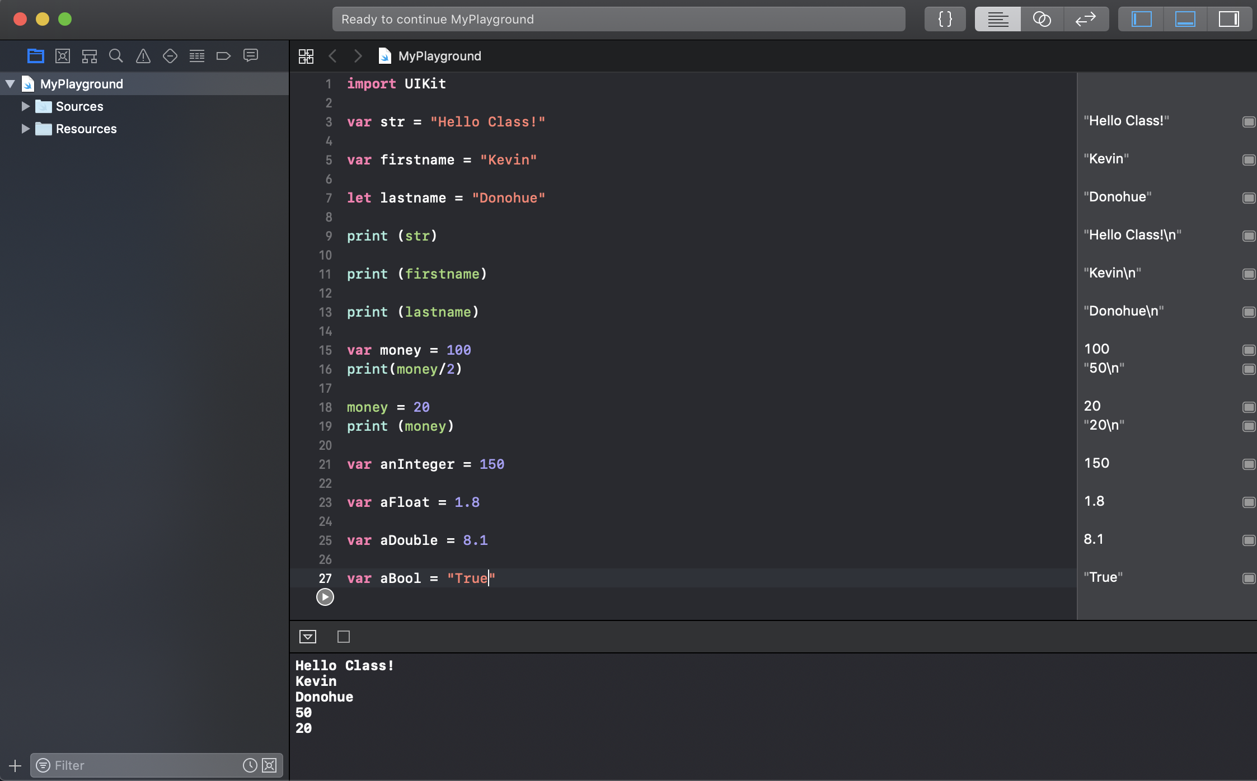
Code Sample

Slide 4
Van Roy Classification
Swift is multi-paradigm programming language
Swift has paradigms that are both “more declarative” and “more imperative” that it works with.
Swift would most aptly be called a “solving library”, using the Objective-C runtime library which it was built around
Some paradigms that Swift adheres to
Object-Oriented Programming (just like C#, Java, Python, and Ruby)
Generic Programming
Apple often brags that Swift is the “first protocol-oriented language” (not actually true).
Generic types are already known known in compile time, but aren’t dictated to by the function definition. Different generic types can reuse the same code.
Protocol-implementations in generic programming create less coupling between types, preventing the unnecessary sharing of base class data.
Community has pushed Swift into more Functional Programming
Swift is not designed to be part of the functional paradigm
But online community and developers have found ways for Swift to engage in more functionality, despite not being designed around a “lambda calculus”

Slide 5
Van Roy Taxonomy
Swift has mutable state and language constructs for operating
Affordances of Object-Oriented Programming and some functional programming
Doesn’t have recursive constructed types, or tail-call optimization
Swift is probably best classified as a object-oriented imperative language with some capacity for functionality programming when modified

Slide 6
Interesting Observations about Swift
Memory is managed automatically by Swift
Variables must always be initialized before use
Array indexes are checked for errors
Common one, out-of-bounds errors
Error handling allows controlled recovery from unexpected failures
Want to look more into this into the future

Slide 7
Swift Design Principles
Swift Design Principles
Regularity, security, simplicity, structure, syntactic consistency, automation
Very simple, very safe, very automated, minimum code left up to the user as possible to evade errors
Definitely not Swift Design Principles
Localized cost: All owners of Apple products are already paying for Swift, whether they use it or not. Costs are not localized, Swift is subsidized by the consumers of Apple products.
Portability: Swift is not portable. Can’t really be used outside the Apple ecosystem. Code has to be modified.

Slide 8
Strengths of Swift
In-demand by employers
14th most popular and most used programming language in the private sector in 2018, far ahead of Objective-C itself
Work for Apple? You’ll be using Swift
Open Source
Went open source one year after release
According to TIOBE, Swift was the fastest growing language in history in 2015-18, although growth of user base has slowed down much recently
Scalability
Safeguards to improve code, prevent errors, and improve readability
Simple and easy syntax. Easy to add new functionalities to product; introduction of new team-members and they’ll know what’s going on quickly
Safeguards can feel constricting and boring at times, may often feel like you’re violating the D.R.Y. principle
Would recommend it as a good “starter language”, if it weren’t so tied to Apple operating systems
Speed
Pretty fast, can be less frustrating than Java
Never had to worry about build/run times with the Xcode application

Slide 9
Swift - Judgement
Readability (5/5)
Very readable, possibly a good language to show a new programmer what’s going on (although it might just be better starting them in Java or Python, Swift may be too simplified)
Writability (4/5)
Very easy to write in, although can become boring/simple. Superior scalability to many other languages. Can bring new teammates in easily.
Reliability (4/5)***
Haven’t run into any bugs or crashes personally. Haven’t heard of internal issues online.
Ecosystem (3/5)
Ecosystem well supported by Apple OS. Can work/transfer in a variety of products that are designed to support Swift
Portability (1/5)
Very poor portability. Most work for Swift has to be done through Apple OS and Apple products..
Swift Community (1/5)
Probably the biggest weakness of Swift (next to poor portability)
Tiny Swift community. Very few full-time Swift experts (almost all work for Apple). Less than 7% of developers on StackOverflow even use Swift.
Major Projects
Vapour - Web Framework for Swift
Alamofire - Chainable response requests/response methods
Brooklyn - Screensavers written in Swift
Coolness
Easy to use, decently cool

Slide 10
Code Demo

Slide 11
https://www.info.ucl.ac.be/~pvr/VanRoyChapter.pdf
http://lucproglangcourse.github.io/principles.html
https://skookum.com/blog/swift-blurs-the-lines-of-programming-paradigms
https://swift.org/blog/swift-linux-port/
https://arstechnica.com/gadgets/2014/06/a-fast-look-at-swift-apples-new-programming-language/
https://www.altexsoft.com/blog/engineering/the-good-and-the-bad-of-swift-programming-language/
https://skywell.software/blog/swift-programming-language-pros-and-cons-for-ios-development/
https://medium.com/issuehunt/top-10-swift-projects-on-github-2e185bdab891
https://medium.mybridge.co/20-amazing-swift-open-source-projects-v-2019-74e5f60fd785
U.S. Patent No. 9329844 (the Swift Patent)

